Slide 1
SQLite Databases
Elvedin Selimoski

Slide 2
SQLite Database
Queries

Slide 3
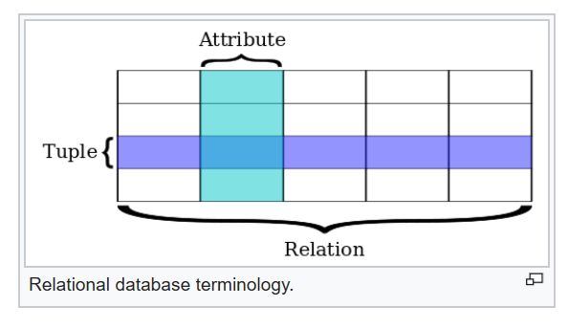
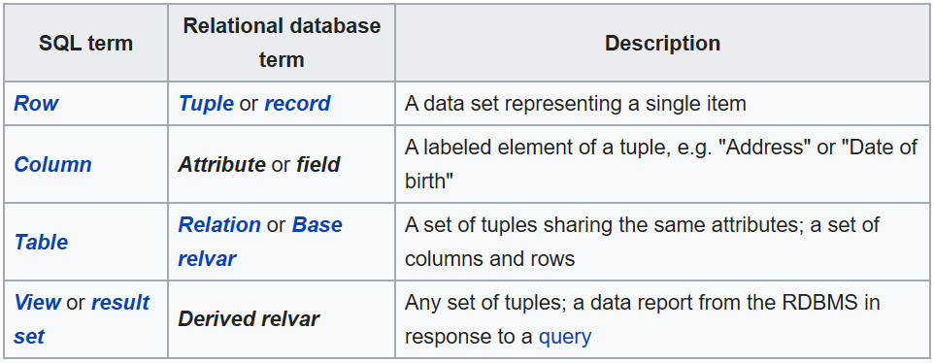
SQL Databases

Slide 4
SQL Databases
Store data in tables of rows and columns (spreadsheet…)
Field = intersection of a row and column
Fields contain data, references to other fields, or references to other tables
Rows are identified by unique IDs
Column names are unique per table

Slide 5
Tables
WORD_LIST_TABLE
_id | word | definition
1 | "alpha" | "first letter"
2 | "beta" | "second letter"
3 | "alpha" | "particle"

Slide 6
SQLite software library
Implements SQL database engine that is
self-contained (requires no other components)
serverless (requires no server backend)
zero-configuration (does not need to be configured for your application)
transactional (changes within a single transaction in SQLite either occur completely or not at all)

Slide 7
What is a transaction?
A transaction is a sequence of operations performed as a single logical unit of work.
A logical unit of work must have four properties
  atomicity
  consistency
  isolation
  durability

Slide 8
All or nothing
All changes within a single transaction in SQLite either occur completely or not at all, even if the act of writing the change out to the disk is interrupted by
program crash
operating system crash
power failure.

Slide 9
ACID
Atomicity—All or no modifications are performed
Consistency—When transaction has completed, all data is in a consistent state
Isolation—Modifications made by concurrent transactions must be isolated from the modifications made by any other concurrent transactions
Durability—After a transaction has completed, its effects are permanently in place in the system

Slide 10
Queries
Elvedin Selimoski

Slide 11
SQL basic operations
Insert rows
Delete rows
Update values in rows
Retrieve rows that meet given criteria

Slide 12
SQL Query
SELECT word, description
FROM WORD_LIST_TABLE
WHERE word="alpha"
Generic
SELECT columns
FROM table
WHERE column="value"

Slide 13
SELECT columns FROM table
SELECT columns
  Select the columns to return
  Use * to return all columns
FROM table—specify the table from which to get results

Slide 14
WHERE column="value"
WHERE—keyword for conditions that have to be met
column="value"—the condition that has to be met
  common operators: =, LIKE, <, >

Slide 15
AND, ORDER BY, LIMIT
SELECT _id FROM WORD_LIST_TABLE WHERE word="alpha" AND definition LIKE "%art%" ORDER BY word DESC LIMIT 1
AND, OR—connect multiple conditions with logic operators
ORDER BY—omit for default order, or ASC for ascending, DESC for descending
LIMIT—get a limited number of results

Slide 16
Sample queries
1 | SELECT * FROM WORD_LIST_TABLE | Get the whole table
2 | SELECT word, definition FROM WORD_LIST_TABLE WHERE _id > 2 | Returns [["alpha", "particle"]]

Slide 17
More sample queries
3 | SELECT _id FROM WORD_LIST_TABLE WHERE word="alpha" AND definition LIKE "%art%" | Return id of word alpha with substring "art" in definition [["3"]]
4 | SELECT * FROM WORD_LIST_TABLE ORDER BY word DESC LIMIT 1 | Sort in reverse and get first item. Sorting is by the first column (_id) [["3","alpha","particle"]]

Slide 18
Last sample query
5 | SELECT * FROM WORD_LIST_TABLE LIMIT 2,1 | Returns 1 item starting at position 2. Position counting starts at 1 (not zero!). Returns [["2","beta","second letter"]]

Slide 19
rawQuery()
String query = "SELECT * FROM WORD_LIST_TABLE";
rawQuery(query, null);
query = "SELECT word, definition FROM WORD_LIST_TABLE WHERE _id> ? ";
String[] selectionArgs = new String[]{"2"}
rawQuery(query, selectionArgs);

Slide 20
query()
SELECT * FROM WORD_LIST_TABLE WHERE word="alpha" ORDER BY word ASC LIMIT 2,1; Returns: [["alpha", "particle"]] | String table = "WORD_LIST_TABLE" String[] columns = new String[]{"*"}; String selection = "word = ?" String[] selectionArgs = new String[]{"alpha"}; String groupBy = null; String having = null; String orderBy = "word ASC" String limit = "2,1" query(table, columns, selection, selectionArgs, groupBy, having, orderBy, limit);

Slide 21
Cursors
Queries always return a Cursor object
Cursor is an object interface that provides random read-write access to the result set returned by a database query
⇒ Think of it as a pointer to table rows

Slide 22
Learn more
SQLite website
Full description of the Query Language
SQLite class
Cursor class

Slide 23
END

